Slide 1

UPOR AND AASTHI PROJECTS
Presented by
Krishna nayak
3rd SEM Mtech URP.

Slide 2
1.A study conducted by Mckinsey in India has shown that India loses 1.3 percent of its potential growth due to poorly maintained land records. Much of the registration process in India does not result in valid ownership titles. Hence, more than 70 per cent of all legal disputes are regarding land. 2.The paper throws light on the initiation Urban Property Ownership Records (UPOR), in Karnataka State, which is a computerized process of land title registration system for urban areas meant to ensure authentication of property titles.
BACKGROUND

Slide 3
3.The process of rapid urbanization in Indian cities has shaped the pattern of economic growth. The massive migration from rural areas to urban centers commenced in the decade 1990-2000 continues till date. 4.As a result, cities have become major centers of industrial development and have contributed to a boom in construction and service sector industries. 5.The expansion of these sectors has created enormous job and investment opportunities and urban sprawl, 50 percent of Karnataka’s population (40 million) is expected to live in urban areas. 6.Existing urban planning instruments are inadequate to deal with the ongoing haphazard development, and may lead to serious regional imbalance in the days to come
BACKGROUND

Slide 4
URBAN PROPERTY OWNERSHIP RECORDS
Urban local bodies (ULBs) in Karnataka have been maintaining property tax details through a property tax record called “Khata”.‘Khata’ document is presumed to be a property ownership record.
The existing city survey system is now being extended to all the major cities of the state as the Urban Property Ownership Rights (UPOR). Initially, pilot projects are being carried out in the cities of Mysore, Hubli-Dharwad, Shimoga, Mangalore and Bellary in order to cover all the municipal and urban properties in stages, in accordance with the provisions of KLR Act. The Act requires the creation of property ownership cards for areas with more than 5000 population.
One of the primary aims of UPOR is to create an approved land record system of documents by a statutory authority in urban areas in order to enable the other stakeholders to make use of this database.
The Survey, Settlement and Land Records Department, Government of Karnataka (GOK), has been mandated under the Karnataka Land Revenue Act of 1964, and KLR Rules of 1966 to prepare, maintain and preserve spatial and non-spatial data relating to ownership of land for properties in urban areas of Karnataka.

Slide 5
OBJECTIVES OF UPOR
The main objective of UPOR is to issue ownership title to urban households and the creation of a fresh data base for urban mapping. The sub-objectives of UPOR include:
Measurement and mapping of all non agricultural lands and urban properties .
Creating and maintaining Record of Rights (RR) for all non agricultural lands.
The preservation of existing land records by the revenue department.

Slide 6
STAGES OF UPOR PROJECT
Creation of Property records which includes (i) survey and mapping of all properties in the cities, and (ii) verification of ownership claims.
Continuous management and maintenance of property records includes (a) creation of property records for new extensions of cities (b) Documenting changes in property records in the context of new constructions, and (c) Updating changes in land use and mutation of property records in case of sale/partition. The above three tasks are performed by the service provider.
Operation and Maintenance of service delivery channels through ‘Bangalore One’ centers to deliver various property record related services to citizens. These service centers are established by the Survey Department.
Creation of IT infrastructure that will enable the storage of property records and delivery of various property record related services like (i) Title Enquiry; (ii) Certifying Transactions and (iii) Changes in property records. The IT infrastructure comprises (a) Software application, (b) Various COTS software products, (c) Servers, Storage and other IT hardware. These activities are carried out by technical service providers.

Slide 7
Governance Structure: Project Monitoring
The progress of each UPOR project was to be monitored by different committees constituted for the purpose. The monitoring activity comprises of three prime execution stages of UPOR project which include:
Constituting Project Monitoring Committee
PMC has been set up for reviewing the progress of the project and also for resolving any disputes between vendors during the implementation of the project.
Constituting Project Management Unit
The PMU is in-charge of core regulatory responsibilities besides supporting the implementation of the project with its expertise.
Inter-departmental Coordination and Coordination between Vendors.
PMU facilitates inter-departmental coordination with other local bodies like Municipalities and Urban Development Departments (UDD) for passing on the required information to the vendors for the smooth implementation of the project objectives.

Slide 8
List of Services ‘Expected to be Delivered’ by UPOR
The following services are expected to be delivered by the UPOR project. information services which includes:
Search for various types of properties and related documents like sale deeds, history of transactions of various properties post UPOR project;
Various thematic layers of maps (for example roads, public amenities, government properties etc.), and search for the entire city-based list of properties based on the parameters of the property database.
Information to owners/power of attorney holder or lessee, bank etc. on transaction initiated in respect of property.
Search and print (certified copies) which includes: (i) certified copies of ownership record and (ii) certified copies of transaction recorded in the UPOR database.
Map services include: (i) maps of the properties with the adjacent properties mapped, (ii) maps of the locality like sector 7 HSR layout and (iii) division of the city into different squares of 1 km to 1 km and mapping of all properties in the maps.

Slide 9
Transaction services include
Transfer of ownership through registration and without registration.
Charge details consist of (a) creation of charge (b) release of charge and (c) reducing charges on the repayment of the loan by the property owner.
Details on recording of any transactions include: power of attorney, long term lease and (iv) details on sub-division of property.
Survey management process for (a) resurvey (b) sub-division and (c) amalgamation cases - these could include special cases such as
The acquisition of land by government for public works
Purchase of 2 adjacent properties by a private individual and the creation of a single commercial/residential building (d) hud bust-refixation of properties and (e) additional services/survey on demand on instructions from courts/agencies and other government departments.
Appeal provision includes handling cases related to courts and court commissions/partitions.
Services related to the municipal department include: the dept of survey settlement and land records, by networking with urban development departments and the city municipal corporation (CMC), maintains details on property taxes, accepts applications for building plan permits and grant permission

Slide 10
IMPLEMENTATION
First Stage of UPOR Implementation: Public-Private Partnership Model (PPP)
The public-private-partnership (PPP) model has been followed for the city survey, wherein private agencies were selected through bidding, and they have to implement the UPOR activities in a phased manner across five pilot cities (Mysore, Mangalore, Bellary, Hubli-Dharwad and Shimoga) in Karnataka.
The PPP would ensure the UPOR implementation within a fixed time frame, while following business model of cost maintenance.

Slide 11
Second Stage of UPOR Implementation: Activities Involved
Generation of Preliminary index map
Data Entry of all Secondary source data
Serving Notice
Demarcation of Property corners by the Department
Collection of Documents from Citizens
Survey with ETS and Generation of Map
Data Entry of Collected Documents
Validation of Survey by the Department
Validation of Spatial and Non Spatial data by SP
Validation of Data by the Department
Submission of Spatial and Non- Spatial records to the Department for Title Enquiry Process

Slide 12
Third stage of UPOR implementation: Title Enquiry Process (TEP)
In the third stage of UPOR implementation, Title Enquiry (TE) process is initiated.
Under TE process, four steps are involved for verifying the ownership claims of properties and the preparation of draft property cards (DPC). They include:
• Based on the data collected during first and second stages, the title enquiry process gets initiated by TEP team.
• Confirmation of tenure and boundaries of the properties.
• Preparation of draft Property Cards.
• Preparation of final Property Card, Enquiry Register and Property Maps.
List of Selected Service Providers for Five Pilot Cities of Karnataka for UPOR Implementation
Name of the City | Name of the Service Provider
Mysore | M/s. SECON Pvt Ltd
Mangalore | M/s. CMS Computers Ltd and Navayuga Saptial Technolohgies Pvt. Ltd
Hubli-Dharwad | M/s. CMS Computers Ltd and Navayuga Saptial Technolohgies Pvt. Ltd
Shimoga | M/s.InfoTech Geospatial (India) Ltd & HCL Infosystems Ltd
Bellary | M/s.Navayuga InfoTech Pvt. Ltd & Map World Technologies Ltd

Slide 13
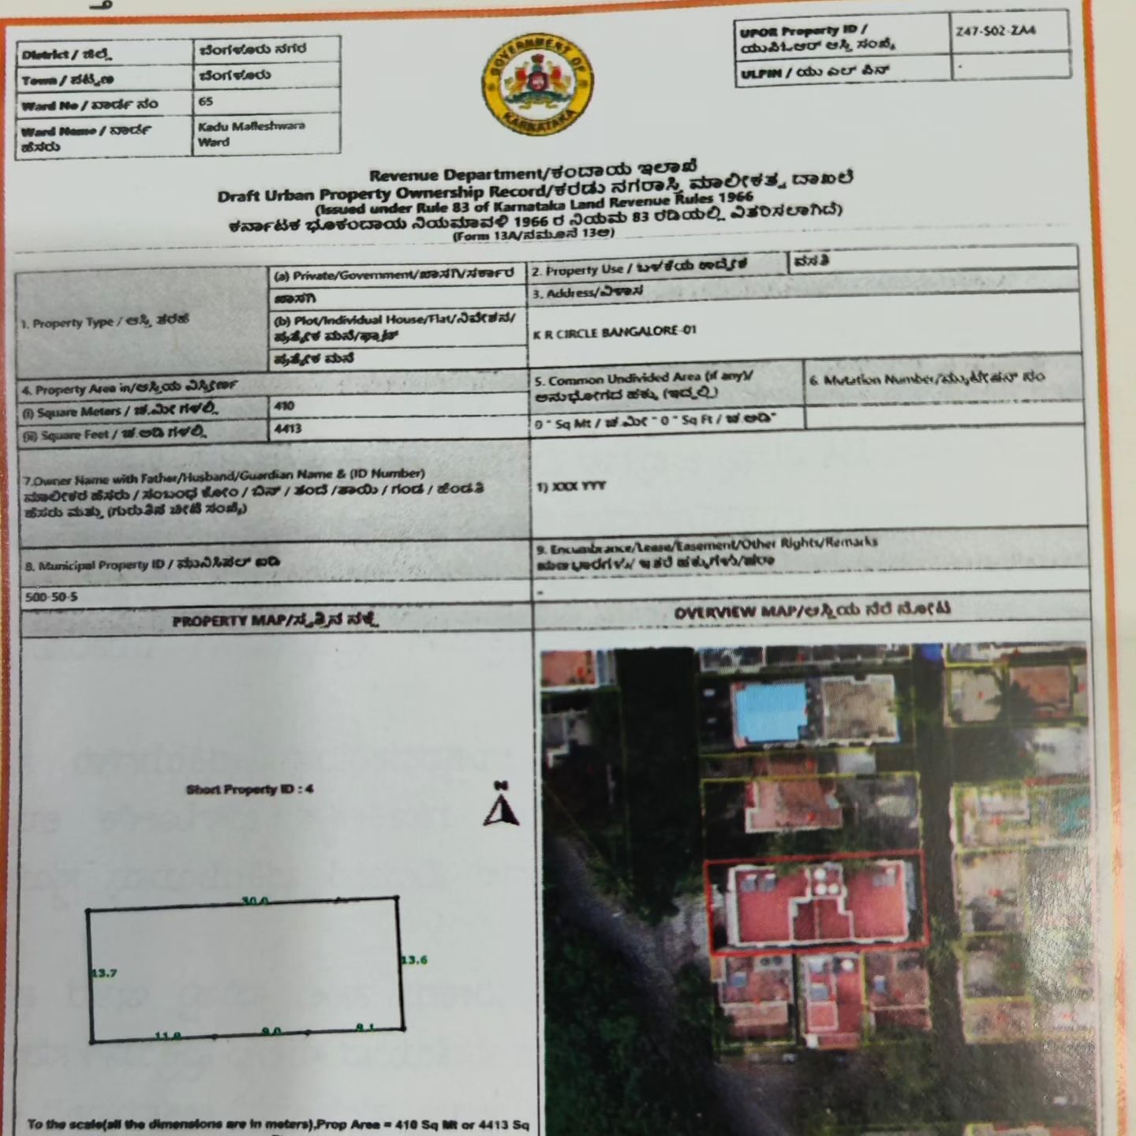
DRAFT IMAGE OF UPOR

Slide 14

AASTHI PROJECT (GIS-BASED PROPERTY TAX SYSTEM)
Assessment of property and creation of property records.
Minimizing the chances of property records tampering.
Real time data on collection of property tax by the ULB.
Easy search and analysis of property details and tax-related data.
Tracking of defaulters on property tax payment.

Slide 15
GIS-based Property Tax Information System Why reforms in property tax….? Issues faced by the department
Low rate of filing the property tax returns
Negligible penalty for not filing the return.
Improper assessment of property tax by ULB officials which was causing huge revenue loss to the ULB
Large number of properties were unassessed and not brought under tax net
Delay in preparing the list of defaulters
Delay in preparing notices to defaulters
Problems in identification of unassessed properties.
Poor rate of tax collection & inaction on mounting arrears

Slide 16
Steps involved are….
Need for reforms in property tax…. Issues from the perspective of citizens/service users
Delay in issuing property tax extract to citizens
Non service of hand written property tax notices to the Property owners by Bill Collector every year
Possibilities of tampering the property details entered manually in paper form
Calculation & clerical Errors in Taxation by Bill Collectors & Revenue Officers.
Street Naming – Street Numbering Property Numbering – Preparation of City Maps –Preparation of Area (Ward) Maps – Identification of Each Property Outlines On Property Level Area (Ward) Maps – Data Entry Of Form C- Mis – Digitization Of Area (Ward) Maps - GIS – Property Details Linking With Digitized Map – Collection Of Data [Form - C]

Slide 17
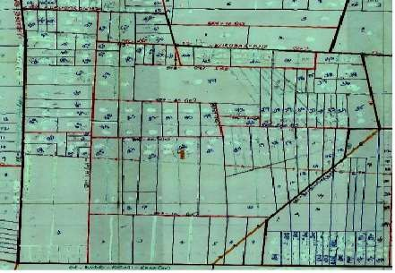
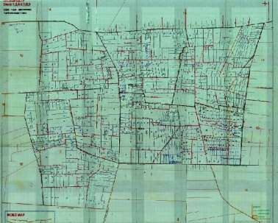
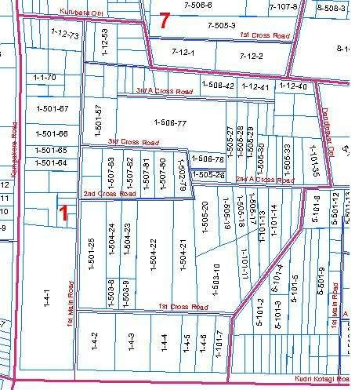
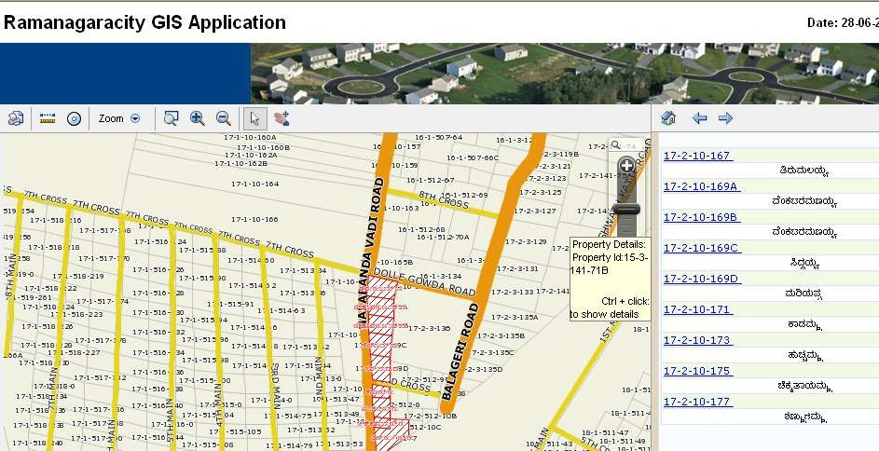
SAMPLE IMAGES OF FIELD WORK
Property Field Survey Map – Zoom
Property Field Survey Map
Digitised Property Blocks

Slide 18
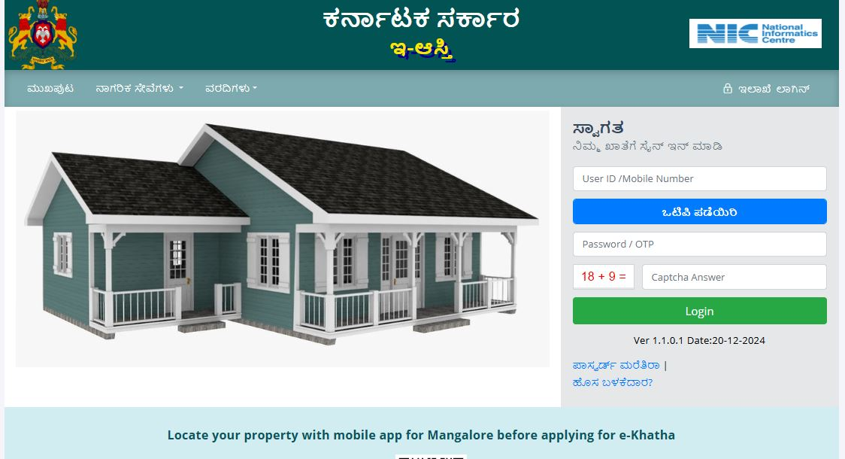
Impact of the Project
PROPERTY TAX DEMAND PRE & POST Aasthi IMPLEMENTATION ( Amount in lakhs )
Name of the ULB | Before | After | Amount of Increase in demand | % Increase
 | Demand | Demand
Gokak | 79.36 | 107.68 | 28.32 | 35.68
Nippani | 64.26 | 79.6 | 15.34 | 23.87
Channapattana | 55 | 70 | 15.00 | 27.27
Hassan | 637.58 | 909.11 | 271.53 | 40.31

Slide 19

Benefits to Citizen
Online property tax calculator application helps citizen to calculate property tax
Citizen can view his property details available in ULB records
Property tax due to ULB can be checked.
Computing automatic property tax demand
Property tax Demand Calculation from
Demand Adjustment due to Property Modifications
Auto Rebate and Cess calculation if any.
Penalties are auto calculated.
Generation of Defaulters List
Automatic generation of demand notices and seizure notices
Online Property Tax Calculator.

Slide 20




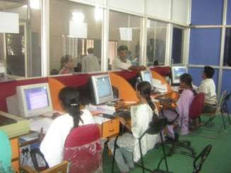


















Good Governance
Transparent Citizen Interface & Timely redressal of Citizen Grievances
Respect for Human Right
Use of IT to improve efficiency / Monitoring of service delivery

Slide 21
THANK YOU

